Slide 1
QUANTITATIVE ANALYSIS BASICS
Order of Operations, Square Roots, Exponents
Calculation of Average – Mean, Median, Mode
Calculation of Standard Deviation
Weighted Average
Moving Average
Growth Rate
Indexing
Rebasing

Slide 2


SYMBOLS
Arithmetic Symbols
Multiplication$∗$ $×$ $∙$
Division / $\frac{a}{b}$ $÷$
Parentheses ( )
Brackets [ ] { }
Exponents $x$ ^ 2, $x$²
Subscripts $x$₁ , $x$₂
Logical Symbols
$=$ Equal to
$≠$ Not Equal to
≤ Less than or equal to
$≥$ Greater than or equal to
$<$ Less than
$>$ Greater than

Slide 3
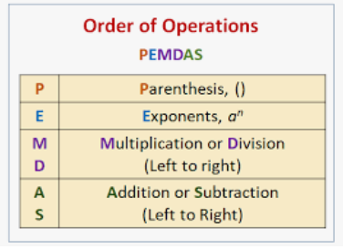
ORDER OF OPERATIONS (PEMDAS)
The Order of Operations matters because we can get different answers to the same problem.
Mathematicians agree to use PEMDAS.
Multiplication is not ranked before division, as M before D might suggest. They are ranked equal in the 3rd tier. We work on an algebraic expression from left-to-right within the tier.
The same rules hold for addition vs. subtraction in the 4th tier.
Notes:
Please Excuse My Dear Aunt Sally

Slide 4
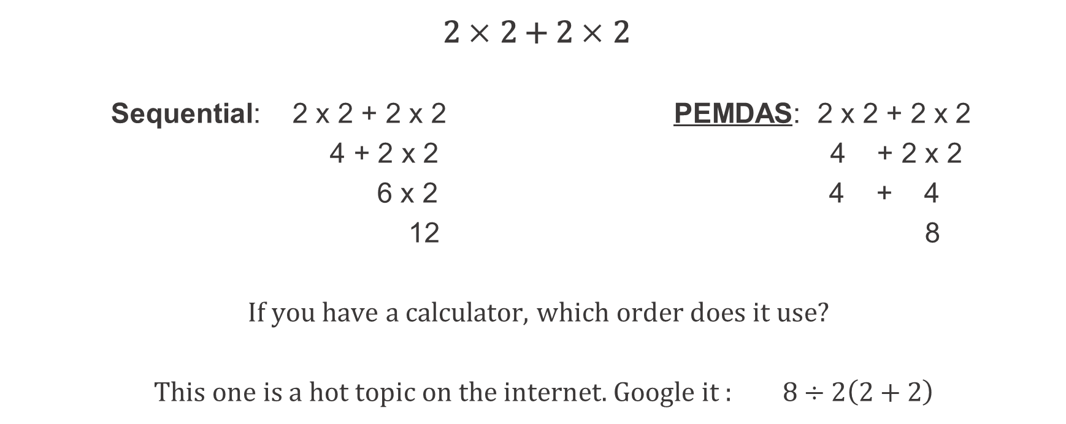
THE ORDER OF OPERATIONS MATTERS
PEMDAS
2 $×$ 2 + 2 $×$ 2
Sequential: 2 x 2 + 2 x 2 PEMDAS: 2 x 2 + 2 x 2
4 + 2 x 2 4 + 2 x 2
6 x 2 4 + 4
12 8
If you have a calculator, which order does it use?
This one is a hot topic on the internet. Google it : $8÷2\left(2+2\right)$

Slide 5
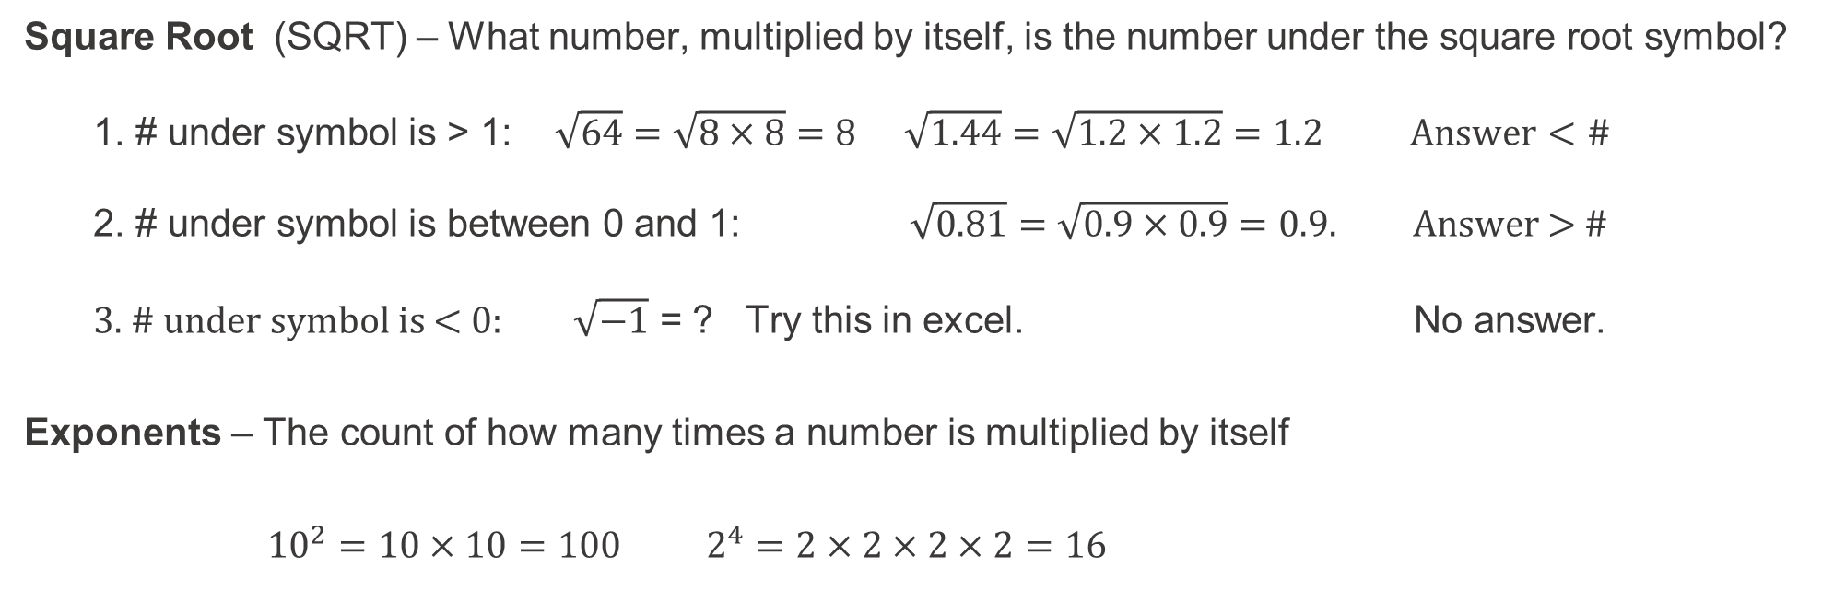
SQUARE ROOTS & EXPONENTS
Square Root (SQRT) – What number, multiplied by itself, is the number under the square root symbol?
1. # under symbol is > 1: $\sqrt{64}=\sqrt{8×8}=8$ $\sqrt{1.44}=\sqrt{1.2×1.2}=1.2$ $Answer<\#$
2. # under symbol is between 0 and 1: $\sqrt{0.81}=\sqrt{0.9×0.9}=0.9.$ Answer > #
3. # under symbol is < 0: $\sqrt{−1}$ = ? Try this in excel. No answer.
Exponents – The count of how many times a number is multiplied by itself
${10}^{2}=10×10=100$ $2^{4}=2×2×2×2=16$

Slide 6
CALCULATION OF AVERAGES
The average is a measure of “central tendency” of the data.
Example: [ 2, 2, 4, 7, 10 ]
There are 3 common types of averages, calculated as:
The MEAN: Add up the data points and then divide by the number of data points.
2+2+4+7+10 = 25 25/5 = 5 Mean = 5
The MEDIAN: Arrange the numbers in order, then pick the middle number. Median = 4
The MODE: The number that appears most often. Mode = 2. If there are no repeats,
the mode does not exist.

Slide 7
CALCULATION OF STANDARD DEVIATION (SD)
Standard Deviation (SD) is a measure of how “spread out” the data is.
The calculation uses PEMDAS, Square Roots, and Exponents.
Ex 1. ( 2, 2, 4, 7, 10 ) has a mean of 5. SD is a measure of the deviations from 5.
SD = SQRT ( ( (2-5)^2 + (2-5)^2 + (4-5)^2 + (7-5)^2 + (10-5)^2 ) / 5 )
= SQRT ( ( 9 + 9 + 1 + 4 + 25 ) / 5 )
= SQRT (48/5) = SQRT (9.6) = 3.10
Ex 2. To compare, ( 3, 4, 5, 6, 7 ) also has a mean of 5, but the SD is:
SD = SQRT ( ( (3-5)^2 + (4-5)^2 + (5-5)^2 + (6-5)^2 + (7-5)^2 ) / 5 )
SD = SQRT ( ( 2^2 + 1^2 + 0^2 + 1^2 + 2^2 ) / 5 )
= SQRT (10/5) = SQRT (2) = 1.41
Both sets have the same mean = 5, but the first is more “spread out”, so has a bigger SD.

Slide 8
EXCEL EXERCISES
Go to the Excel exercises in your workbook. The answers are to the far right on each tab.
Tabs
OrdOps
SqR_Exp
Avg
SD

